Slide 1
Overview Linux
1. Features
2. Architecture
3. Basic concept

Slide 2
Features
Portable
Open Source
Multi-User
Multiprogramming
Hierarchical File System
Shell
Security
Notes:
Portable - Portability means softwares can works on different types of hardwares in same way.Linux kernel and application programs supports their installation on any kind of hardware platform.
Open Source - Linux source code is freely available and it is community based development project. Multiple teams works in collaboration to enhance the capability of Linux operating system and it is continuously evolving.
Multi-User - Linux is a multiuser system means multiple users can access system resources like memory/ ram/ application programs at same time.
Multiprogramming - Linux is a multiprogramming system means multiple applications can run at same time.
Hierarchical File System - Linux provides a standard file structure in which system files/ user files are arranged.
Shell - Linux provides a special interpreter program which can be used to execute commands of the operating system. It can be used to do various types of operations, call application programs etc.
Security - Linux provides user security using authentication features like password protection/ controlled access to specific files/ encryption of data.

Slide 3
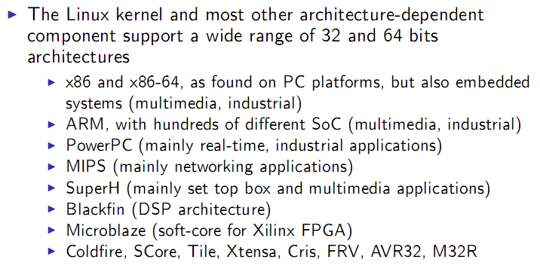
Processor and architecture

Slide 4
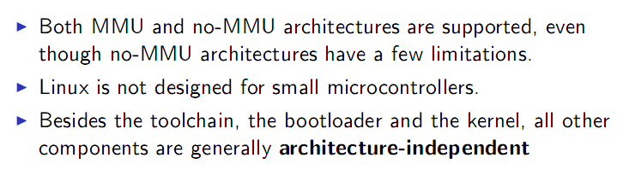
Processor and architecture

Slide 5
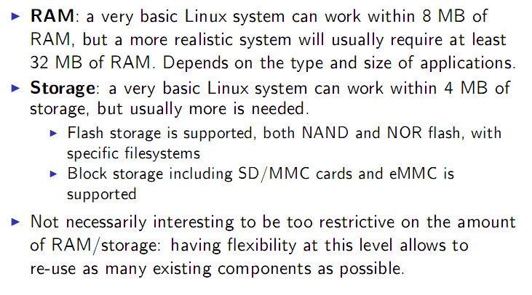
RAM and storage

Slide 6
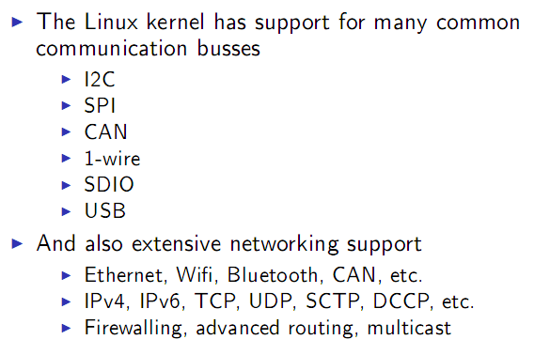
Communication

Slide 7
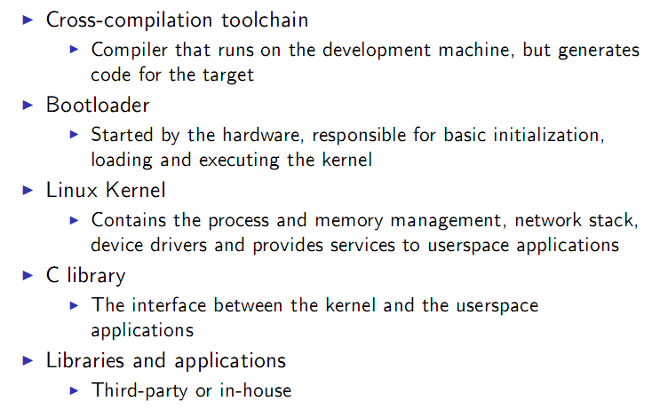
Software components

Slide 8
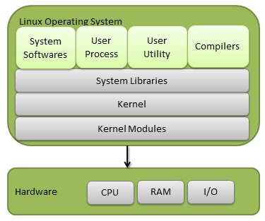
Linux System
Notes:
Kernel:
It is responsible for all major activities of this operating system.
It is consists of various modules and it interacts directly with the underlying hardware.
Kernel provides the required abstraction to hide low level hardware details to system or application programs.
System Library
System libraries are special functions or programs using which application programs or system utilities accesses Kernel's features.
These libraries implements most of the functionalities of the operating system and do not requires kernel module's code access rights.
System Utility
System Utility programs are responsible to do specialized, individual level tasks

Slide 9
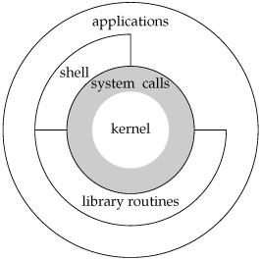
Linux architecture
Kernel
System calls
Shell
Applications
Notes:
Kernel- Core component of Operating System, interacts directly with hardware, provides low level services to upper layer components.
Shell- An interface to kernel, hiding complexity of kernel's functions from users. Takes commands from user and executes kernel's functions.
Applications- Utility programs giving user most of the functionalities of an operating systems.
System calls: the main interface userspace and kernel

Slide 10
Kernel Mode vs User Mode
Kernel mode:
  full access to all resources of the computer: kernel code & hardware
  a single process, executes in single address space and do not require any context switch
User mode:
  no access to system hardware and kernel code
  use System libraries to access Kernel functions to get system's low level tasks.
Notes:
Kernel component code executes in a special privileged mode called kernel mode with full access to all resources of the computer. This code represents a single process, executes in single address space and do not require any context switch and hence is very efficient and fast. Kernel runs each processes and provides system services to processes, provides protected access to hardwares to processes.
Support code which is not required to run in kernel mode is in System Library. User programs and other system programs works in User Mode which has no access to system hardwares and kernel code. User programs/ utilities use System libraries to access Kernel functions to get system's low level tasks.

Slide 11
System calls
The main interface between the kernel and userspace is the set of system calls
About 300 system calls that provide the main kernel services
This system call interface is wrapped by the C library, and userspace applications usually never make a system call directly but rather use the corresponding C library function
Notes:
The main interface between the kernel and userspace is the set of system calls
About 300 system calls that provide the main kernel services
File and device operations, networking operations, inter-process communication, process management, memory mapping, timers, threads, synchronization primitives, etc.
This interface is stable over time: only new system calls can be added by the kernel developers
This system call interface is wrapped by the C library, and userspace applications usually never make a system call directly but rather use the corresponding C library function

Slide 12
Virtual filesystems
Linux makes system and kernel information available in user-space through virtual _x000c_filesystems.
Virtual filesystems allow applications to see directories and files that do not exist on any real storage: they are created on the fly by the kernel
The two most important virtual filesystems are
  proc
  sysfs
Notes:
Linux makes system and kernel information available in user-space through virtual filesystems.
Virtual filesystems allow applications to see directories and files that do not exist on any real storage: they are created on the fly by the kernel
The two most important virtual filesystems are
- proc, usually mounted on /proc: Operating system related information (processes, memory management parameters...)
- sysfs, usually mounted on /sys: Representation of the system as a set of devices and buses. Information about these devices.
A virtual file system (VFS) is an abstraction layer that resides above a file system and provides an interface between the kernel and the file system. Through a VFS, client applications can access different file systems.
During the initialization of each file system, the file system registers itself with the VFS. This occurs as the operating system initializes itself at startup. The real file systems are generally built as loadable modules or built directly into the kernel. For instance, the VFS can access local and network storage devices transparently without the client application knowing the actual file systems

